Slide 1
Employee Iteration Case Study
CHINMAY MUNDHADA

Slide 2
Business Objective
Problem Statement : XYZ company HR has recently noticed an increase in their attrition rate compared to what they have seen last year. They feel that there are some specific reasons driving the higher observed attrition rate. They have approached you to analyse the data and give them insights and recommendations on 1. Causes of Attrition 2. Possible Recomendations to tackle high attrition
In this case we are using Exploratory Data Analysis to analyze the problem statement, and we further use model development to check what are possible top features contributing to resignation of employee.

Slide 3
Data Cleaning
Handling Missing Values
Remove Columns with 100% Null Values
Drop Non-Unique Columns
Assess and Drop Columns with High Null Percentage
Exclude Unnecessary Columns

Slide 4
Exploratory Data Analysis
The analysis has been performed based on both numeric and categorical features to comprehensively understand the data.
1. Univariate Analysis
Description: Examines each numeric and categorical feature individually.
Purpose: To understand the distribution and summary statistics (e.g., mean, median, mode) of each feature.
Outcome: Provides insights into the general characteristics and distribution of features, helping to identify patterns and anomalies.
2. Segmented Univariate Analysis
Description: Analyzes numeric and categorical features within different segments or groups.
Purpose: To explore how feature distributions vary across different segments (e.g. : awards won? ,region).
Outcome: Highlights differences between segments, revealing how feature characteristics influence or are influenced by segment-specific behaviors.
3. Bivariate Analysis
Description: Investigates the relationship between two variables, exploring how they interact with each other.
Purpose: To identify correlations or dependencies between pairs of features, such as age and length of service.
Outcome: Provides insights into how changes in one variable might impact another, aiding in understanding relationships that drive default or repayment behaviors.

Slide 5
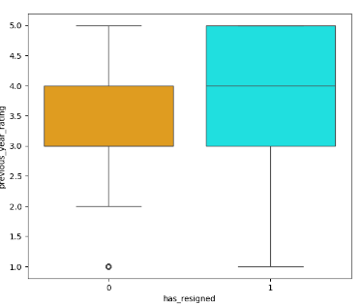
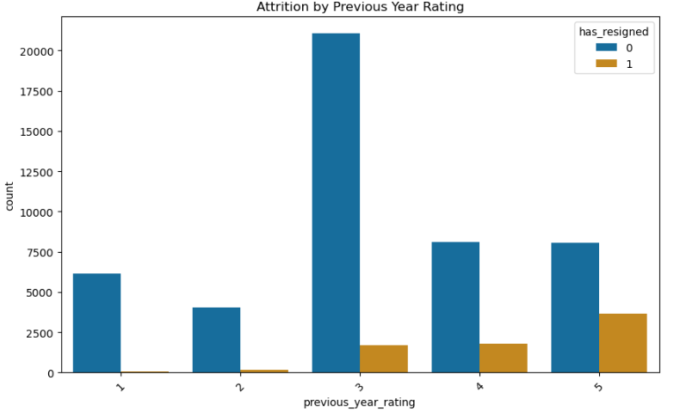
previous_year_rating
As you can from the boxplot clearly employees with higher previous_year_rating are the ones who will resign early.

Slide 6
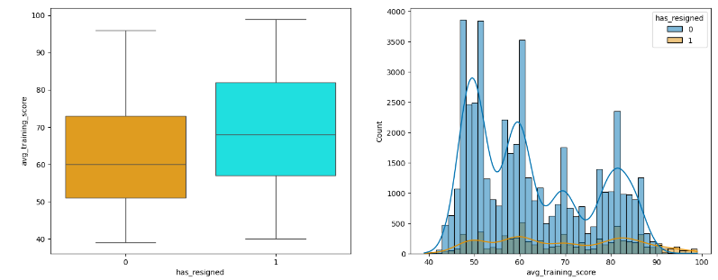
avg_training_score
As you can see from the box plot the median for avg_training_score is comparatively higher than the ones who have stayed back with the company.

Slide 7
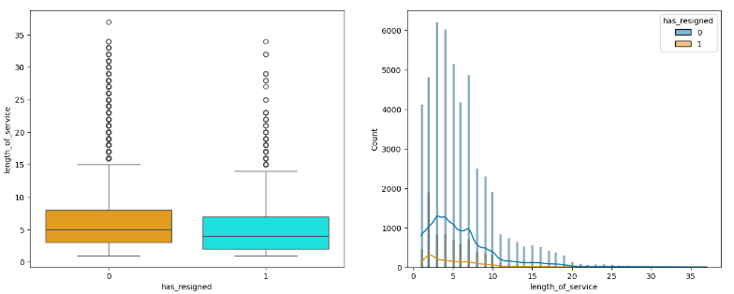
length_of_serivce
Employees with shorter lengths of service (0-2 years) are more likely to resign.
After about 5 years of service, the likelihood of resignation seems to diminish, and those who have stayed longer tend to continue staying.

Slide 8
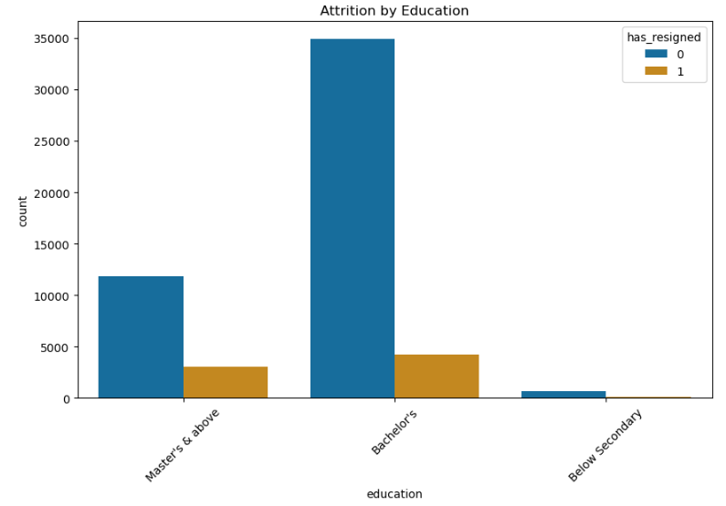
education
The ratio of the resignation for employees with education of Master’s and above are comparatively higher than the ones with Bachelor’s

Slide 9
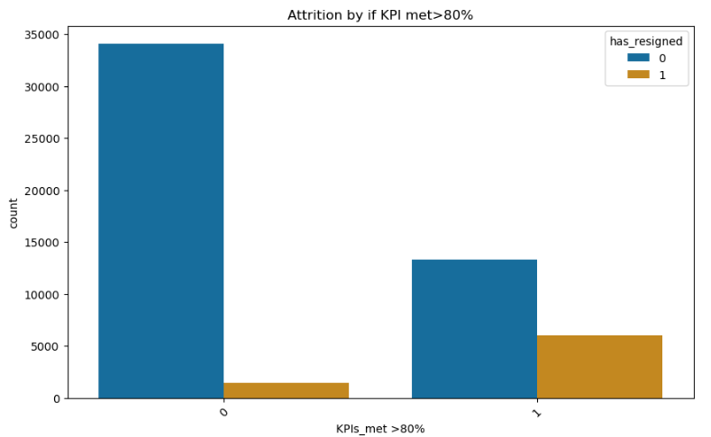
KPIs_met>80%
The employees who have met more than 80% of KPIs in previous year are more prone to resign from the company rather than the ones who have not met 80% of KPIs.

Slide 10
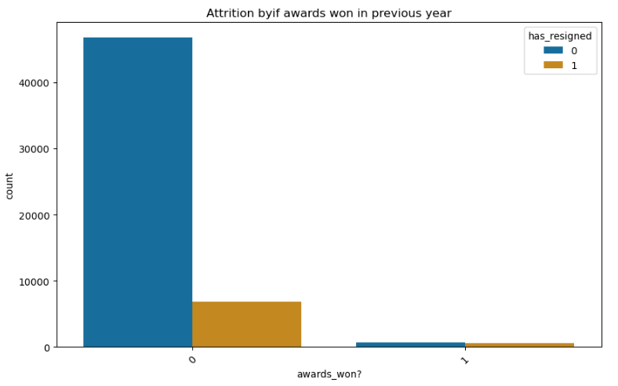
Awards_won?
The resignation rate is comparatively higher from the ones who won award in previous year rather than the ones who have not won the awards.

Slide 11
Building the model ( Optional Step)
Feature Engineering
Build the model
Predict probabilities on the model
Evaluating model performance
Finding the top features from the model

Slide 12
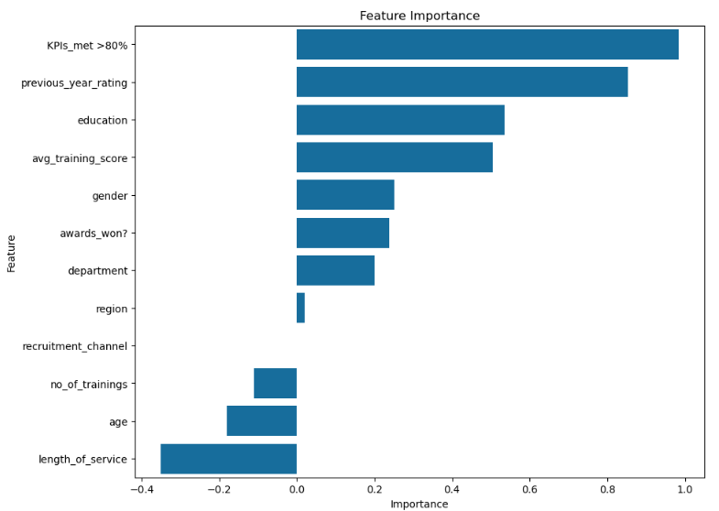
Top contributing features for Logistic Regression

Slide 13
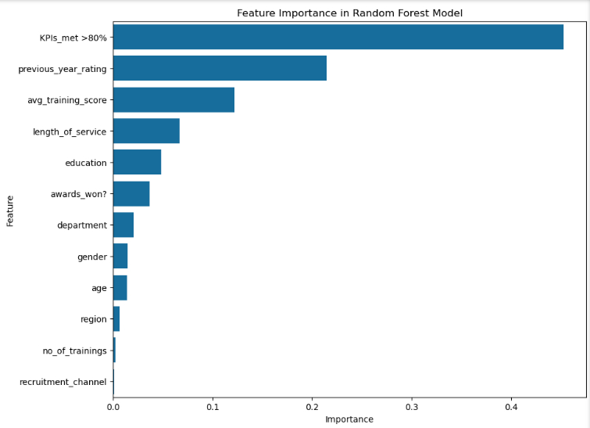
Top features for Random Forest Classification Model

Slide 14
Insights from model building
We created model to cross validate our top features from Exploratory Data Analysis.
We tried Logistic Regression model , Random Forest Classification with and without class_weight.
The major difference between two RF model is that assigning class_weight increases the recall but reduces the accuracy of the model which is the trade-off we need to deal with.
From all of the models we can conclude that KPIs_met>80% ,previous_year_rating ,avg_training_score, education, length_of_service and award_won?

Slide 15
Conclusions : Causes of Iteration
Department
R&D department shows a slightly higher resignation rate.
Region
Regions 4, 25, and 28 have higher resignation rates, suggesting possible regional issues.
Education
Higher-educated employees are more likely to resign than those with only a Bachelor’s degree.
Gender
Gender does not significantly impact resignation rates.
Recruitment Channel
Employees recruited through referrals tend to resign more often.
Number of Trainings
Employees with fewer training opportunities are more likely to resign.
Age
Age does not significantly impact resignation rates.
Previous Year Rating
High performers with better ratings are more likely to resign.
Length of Service
Employees with less than 5 years of service are more prone to resign.
KPIs Met >80%
High-performing employees who consistently meet or exceed KPIs are more likely to resign.
Awards Won
Award-winning employees are also more likely to leave.
Average Training Score
Employees with higher training scores are more likely to seek opportunities elsewhere.

Slide 16
Recommendations to reduce iteration rate for XYZ company
Enhance Employee Recognition Programs
Access to Training and Development
Improve Employee Onboarding and Integration
Conduct Regular Employee Engagement Surveys
Tailor Career Development Plans
Focus on Retaining Newer Employees
Regional Focus

Slide 17
THANK YOU

